Slide 1
CIS 25 day 4
functions, arrays, call stack, strings, style guide

Slide 2
CONST, AND WHY NO GLOBALS
the const keyword, and why non-const global variables are off limits

Slide 3
CONST CATCHES MISTAKES FOR YOU
If you (or a teammate) accidentally try to reassign a const variable, the code won't compile.
This turns a silent logic bug into a loud, immediate compiler error -- exactly when you want to find it.
const int MAX_SCORE = 100;
...
MAX_SCORE = 200; // oops
error: assignment of read-only
variable 'MAX_SCORE'
MAX_SCORE = 200;
~~~~~~~~~ ^ ~~~
the compiler refuses to build this program

Slide 4
STYLE: NAMING CONSTANTS
This connects to a rule from the style guide: names of constants should be in ALL_CAPS.
No "magic numbers." If you use a number repeatedly (or even just once, if it needs explaining), give it a name.
Use const int ARRAY_SIZE = 4; instead of scattering the number 4 through your code.
// unclear -- what is 4? what is 0.15?
double tax = price * 0.15;
// clear -- self-documenting
const double TAX_RATE = 0.15;
double tax = price * TAX_RATE;

Slide 5
WHY NO NON-CONST
GLOBAL VARIABLES?

Slide 6
PROBLEM: NAMESPACE POLLUTION
A global variable's name is visible to every file and function in your program.
In a big program (or one built from several files), it's easy for two globals to accidentally collide -- same name, different intended meaning.
Local variables don't have this problem: two functions can each safely use a variable named count.
// physics.cpp
double count; // particles
// grading.cpp
int count; // # of students
// linker error: 'count'
// defined more than once
same name, two different meanings -- collision

Slide 7
PROBLEM: TESTABILITY
A function that reads or writes a global has hidden inputs and outputs -- its behavior depends on state that isn't in its parameter list.
To test it, you can't just call it with inputs and check the output. You first have to set up the right global state, and that setup can leak between tests.
A function that only uses its parameters and local variables is easy to test in isolation.
int total; // global
void addToTotal(int n) {
total += n;
}
// to test this, you must first
// set 'total' correctly yourself
hidden dependency on state outside the function

Slide 8
PROBLEM: DEBUGGING
A global can be changed by any function, anywhere in the program, at any time.
When it holds a wrong value, you have no way to narrow down where -- you have to search the entire codebase.
A local variable can only be changed inside the one function (or block) it lives in, so a bug is much easier to trace.
int score; // global
void f() { score++; }
void g() { score = 0; }
void h() { score -= 5; }
// score is wrong. which one
// of these did it? all of
// them can reach it.
any function can reach in and change it -- no way to narrow the search

Slide 9
AGENDA
Arrays & two-dimensional arrays
More recursion! More! More!
(mostly this is just to introduce you to the call stack, but I’ll show a pretty fun technique too)
String functions
Style guide

Slide 10
PASS BY REFERENCE VS. PASS BY VALUE

Slide 11
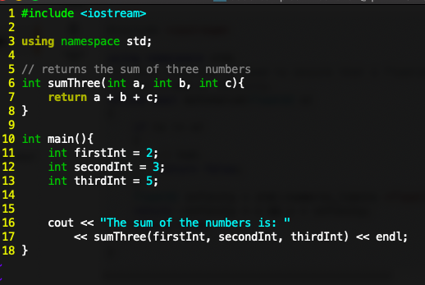
PASS BY VALUE
Consider this relatively straightforward program. The function sumThree takes in three integers, then returns their sum as an integer:
one-line function that just returns a sum

Slide 12
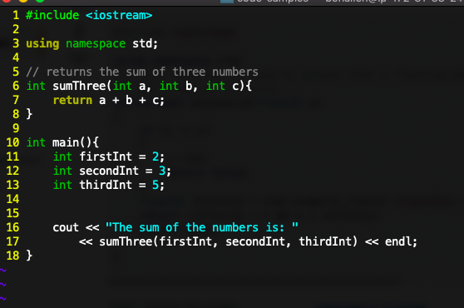
PASS BY VALUE
When sumThree is called (on line 17), the values of the three variables given as arguments are copied into the parameters of sumThree
So when we hit line 17, we call sumThree. When we call sumThree, three new ints (named a, b, and c) are declared, and their values are set equal to the values of the variables given as arguments.

Slide 13
PASS BY VALUE
When sumThree is called (on line 19), the values of the three variables given as arguments are copied into the parameters of sumThree:
main:
firstInt 2
secondInt 3
thirdInt 5
sumThree:
a 2
b 3
c 5
a, b, and c are totally new variables, that are set equal to the values of firstInt, secondInt, and thirdInt when the sumThree function is called.

Slide 14
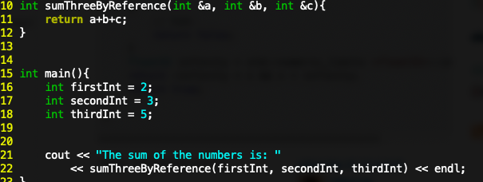
PASS BY REFERENCE
Now consider this version of the program:
it works exactly the same… but we pass in each of the variables by reference. This means that instead of copying the value stored in a particular variable, we give the address of that variable.
What's the difference?
You indicate that a variable is passed by reference by putting a & sign before the variable name when specifying the parameters:

Slide 15
PASS BY REFERENCE
When sumThreeByReference is called on line 22, this time no new variables are made. 'a' in sumThreeByReference is literally the same variable as firstInt in main:
main:
firstInt 2
secondInt 3
thirdInt 5
sumThree:
a
b
c
a, b, and c are not copies of firstInt, secondInt, and thirdInt. They are instead new names referring to firstInt, secondInt, and thirdInt.

Slide 16
PASS BY VALUE
What difference does it make? Let's try changing the values of variables in sumThree:
main:
firstInt 2
secondInt 3
thirdInt 5
sumThree:
a 2
b 3
c 5
a, b, and c are totally new variables, that are set equal to the values of firstInt, secondInt, and thirdInt when the sumThree function is called.

Slide 17
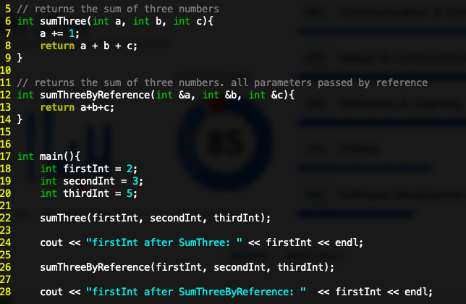
PASS BY VALUE
What difference does it make? Let's try changing the values of variables in sumThree:
5
result: as expected, firstInt is unchanged

Slide 18
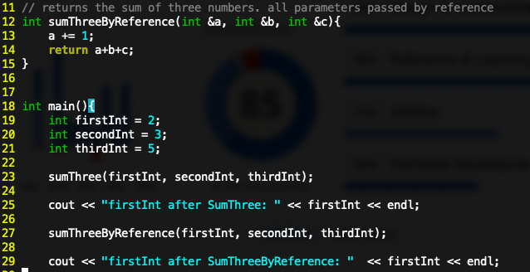

PASS BY REFERENCE
What difference does it make? Let's try changing the values of variables in sumThreeByReference:
5
result: after sumThreeByReference, firstInt is increased by 1

Slide 19
PASS BY REFERENCE
This is because firstInt and a are literally the same variable.
main:
firstInt 2
secondInt 3
thirdInt 5
Both firstInt and a are exactly the same thing, just by different names
sumThree:
a
b
c
a, b, and c are not copies of firstInt, secondInt, and thirdInt. They are instead new names referring to firstInt, secondInt, and thirdInt.

Slide 20
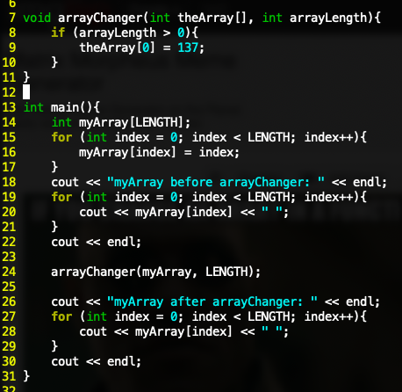

WHY PASS BY REFERENCE MATTERS #1
Arrays are always pass-by-reference. Remember that if you change an array in a function, it changes it everywhere
this produces
the following
output:

Slide 21
ARRAYS[]

Slide 22

ARRAYS
So let's (formally) talk about arrays.
Declare an array by either giving the number stored in the array in brackets: int myArray[50]; // declares a 50 element array of ints
Or by explicitly initializing the array: int evensArray[] = {2, 4, 6, 8, 10};
If you want, you can partially initialize the array: double partialArray[10] = {2.0, 5.0, 7.0}
the first three elements in this array are initialized. The next seven aren't.

Slide 23
ARRAYS
An array of length n that stores variables of type t is in memory a contiguous block of n * (size of one variable of type t) bytes.
For an array named num, num[0] is the value stored at the address of the (size of t) bytes of the array in memory.
Copying an array into another array must be done component by component. To copy a 5-element array, you must do something like this. for (int index = 0; index < 5; index++){ newArray[index] = oldArray[index]; }

Slide 24


ARRAYS
An array of length n that stores variables of type t is in memory a contiguous block of n * (size of one variable of type t) bytes.
For an array named num, num[0] is the value stored at the address of the (size of t) bytes of the array in memory.
Copying an array into another array must be done component by component. To copy a 5-element array, you must do something like this. for (int index = 0; index < 5; index++){ newArray[index] = oldArray[index]; }
If you try this you will get an error: newArray = oldArray;

Slide 25
CONSTRAINTS ON ARRAYS
Functions cannot return arrays
Arrays are always (effectively) pass-by-reference – when you pass an array to a function, you are passing the address of the first element in the array.
Officially in C++ you cannot use variables as sizes in array declarations; i.e. int size = 10; int myArray[size]; is not standard C++. Some compilers (most notably gcc) allow this as an extension. Please do not do this in your assignments – we want to whenever possible stick to standard C++.
(you will not often hear me badmouthing gcc. but even so, I think it was a bad idea for them to include this).
You CAN use a constant to set array size: i.e. const int ARRAY_SIZE = 4; int myArray[ARRAY_SIZE]; is perfectly fine

Slide 26
String objects
and how to manipulate them

Slide 27
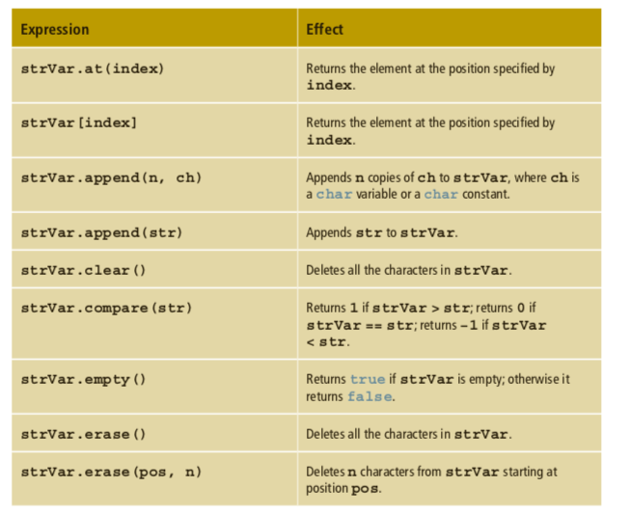
SOME STRING FUNCTIONS
(See page 496 of textbook)
apologies for how ugly /boring these slides are…

Slide 28
SOME STRING FUNCTIONS
(See page 496 of textbook)
note that these two are equivalent: the array subscript notation is included to maintain compatibility with C

Slide 29
SOME STRING FUNCTIONS
(See page 496 of textbook)
you can place either chars or other strings at the end of a string

Slide 30
SOME STRING FUNCTIONS
(See page 496 of textbook)
VERY USEFUL

Slide 31
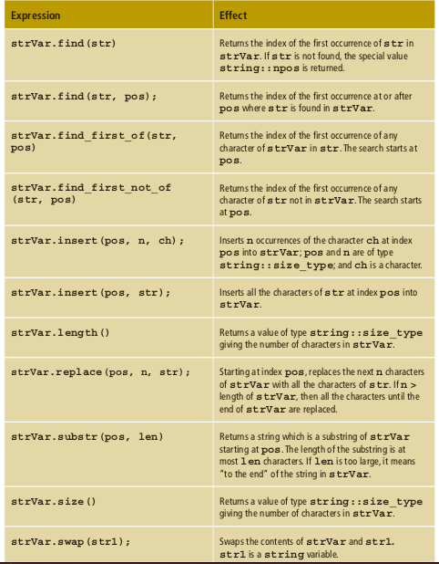
MORE STRING FUNCTIONS
(See page 497 of textbook)
(for anyone who's had to work with regular c-strings (arrays of chars), you'll really appreciate every last one of these functions.)
potential pitfall: technically, str.length() returns a variable of type size_t. it is best practice when printing a size_t to cast it to an int: i.e.,
cout << static_cast<unsigned int> strVar.length();

Slide 32
style guide
please follow this, for your sake and for mine

